Slide 1

SENIOR PROJECT II ADVANCED DRIVER ASSISTANCE SYSTEMS(ADAS)

Slide 2
INTRODUCTION
CH 1

Slide 3
Problem Statement and Purpose
The increase in cars led to an increase in traffic accidents.
According to the World Health Organization, nearly 1.3 million people die every year as a result of road accidents.
There are many causes of traffic accidents.
Advanced driver-assistance systems(ADAS).
Adaptive Cruise Control System (ACC).

Slide 4
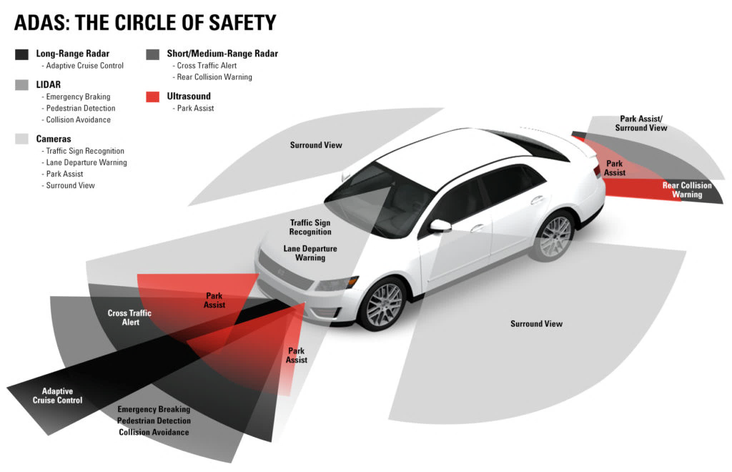
ADAS:The circle of safty

Slide 5
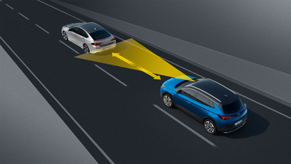
ACC
Adaptive Cruise Control

Slide 6
Project and Design Objectives
Our main objective is to implement an ACC.
The overall system is controlled by an android application.
The application offers manual driving or the ACC's extra functionality.
The application turns on (or off) the ACC to keep the car at the speed limit.

Slide 7
BACKGROUND
CH 2

Slide 8
Related Work
Increasing global demand for enhanced driver safety, comfort, and convenience requires adaptive cruise control (ACC) systems in cars. Understanding this evolution provides insight for researchers. Therefore, we point to some projects to show their recent stages of development in ACC.

Slide 9
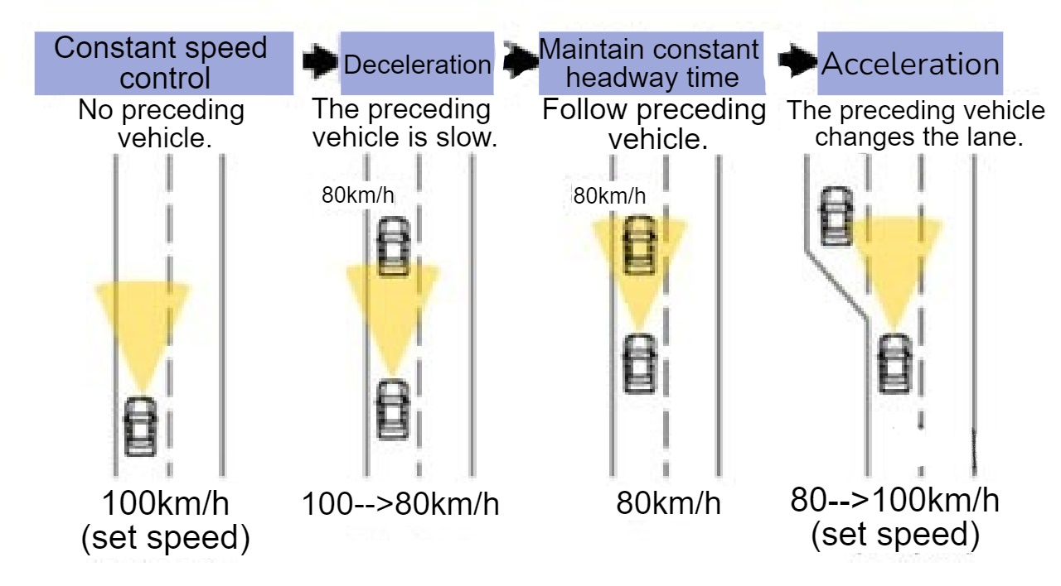
Fully Automated Cruise Control System Using Ultrasonic Sensor

Slide 10
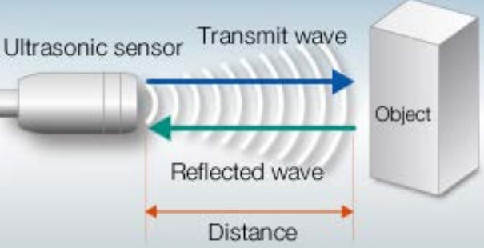
Remote and Autonomous Controlled Robotic Car based on Arduino with Real Time Obstacle Detection and Avoidance.

Slide 11
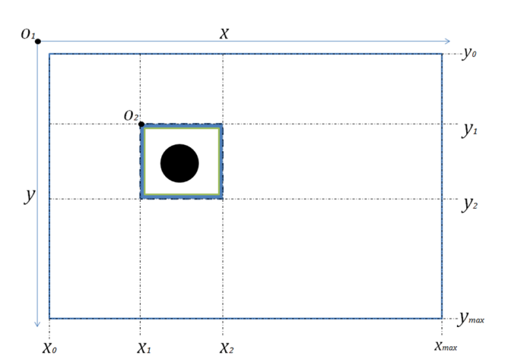
Vision-Based Adaptive Cruise Control Using Pattern Matching

Slide 12
METHODS AND MATERIALS
CH 3

Slide 13
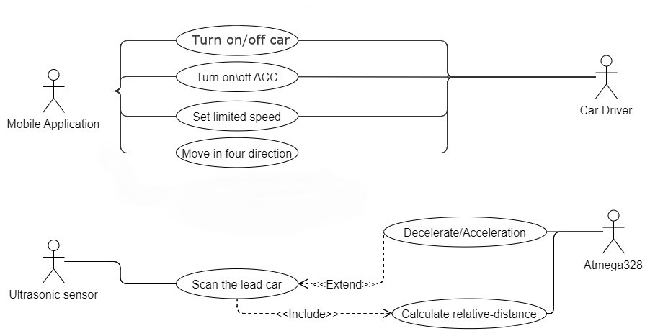
ACC use case

Slide 14
ACC Sequence Diagrams

Slide 15
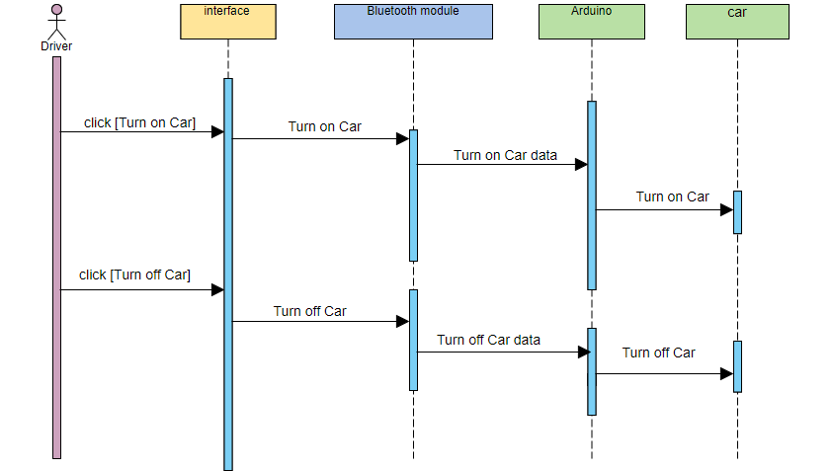
Turn on/off car sequence

Slide 16
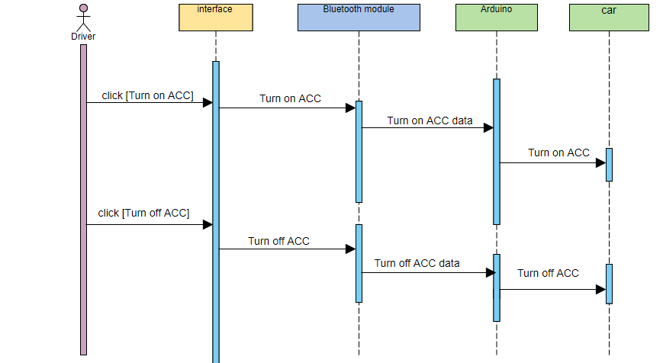
Turn n/off ACC sequence

Slide 17
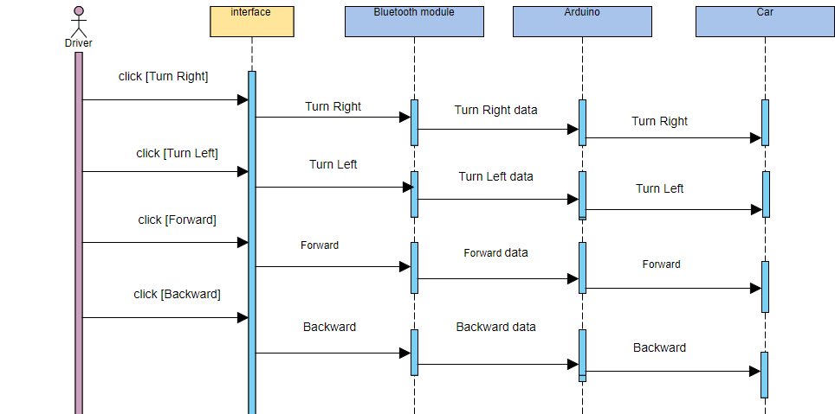
Move the car in four direction sequence

Slide 18
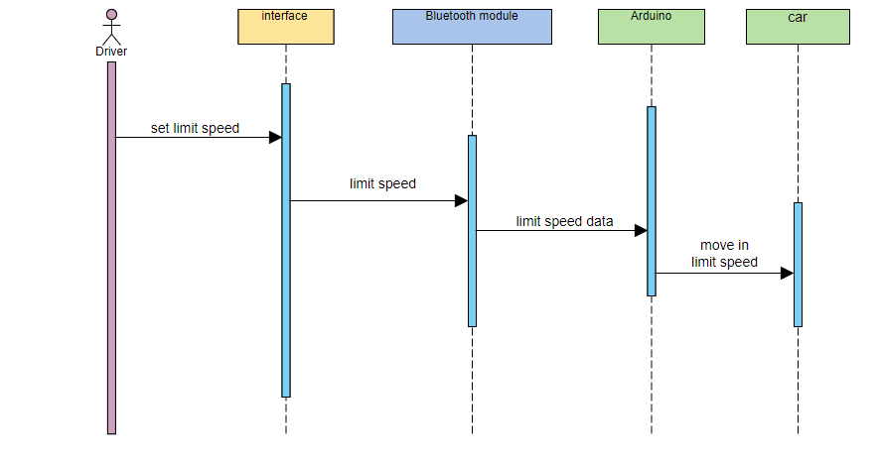
Set limit speed sequence

Slide 19
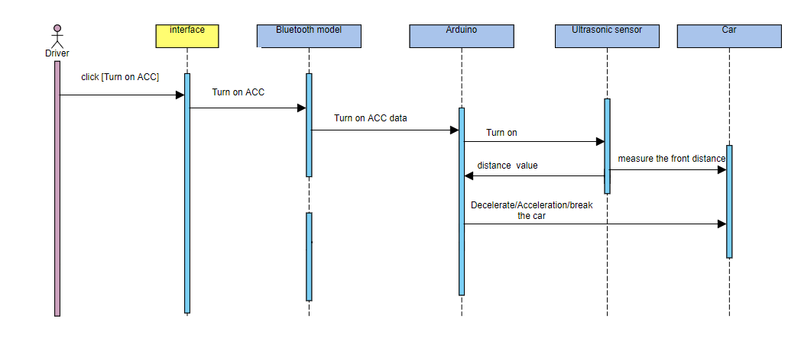
Hardware sequence

Slide 20
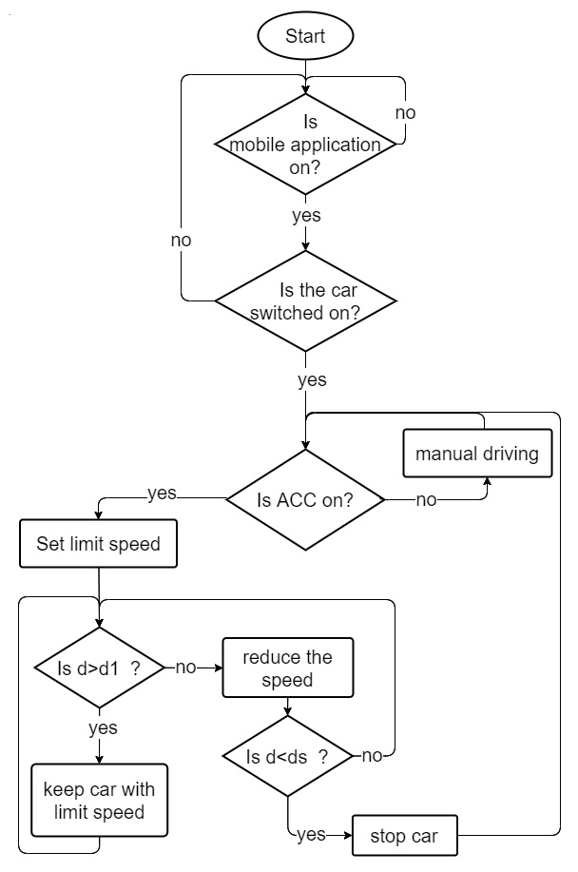
ACC flow chart

Slide 21
Design Alternatives

Slide 22
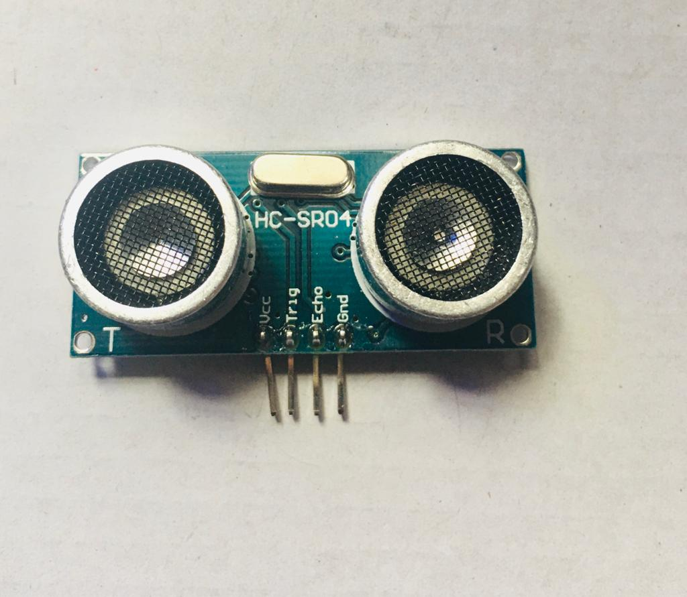
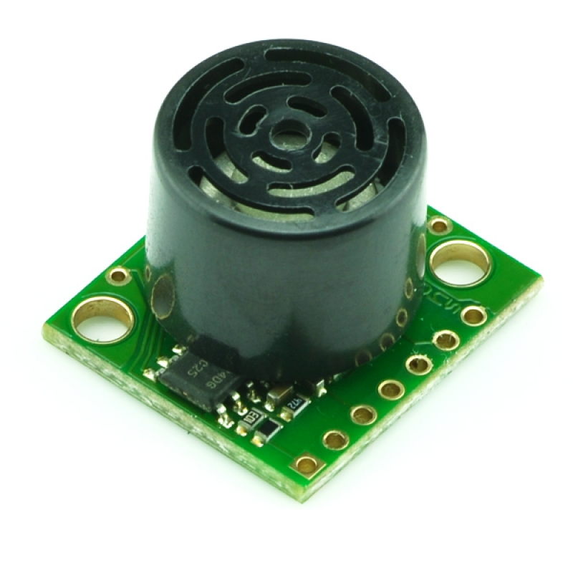
Ultrasonic Sensor Module HC-SR-04
Ultrasonic Range Finder-LV-MaxSonar-EZ1

Slide 23
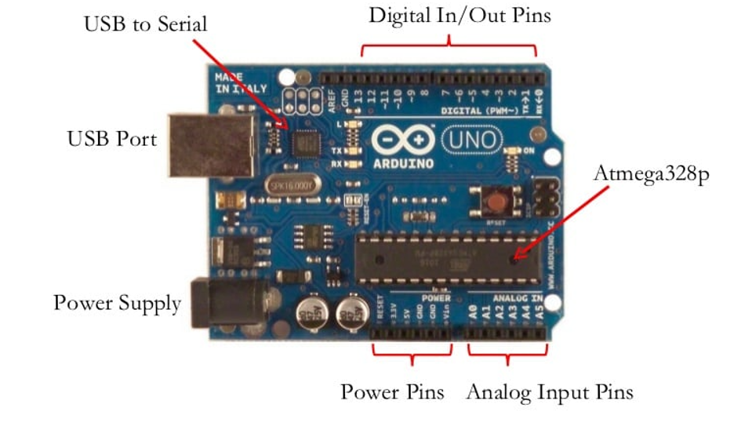
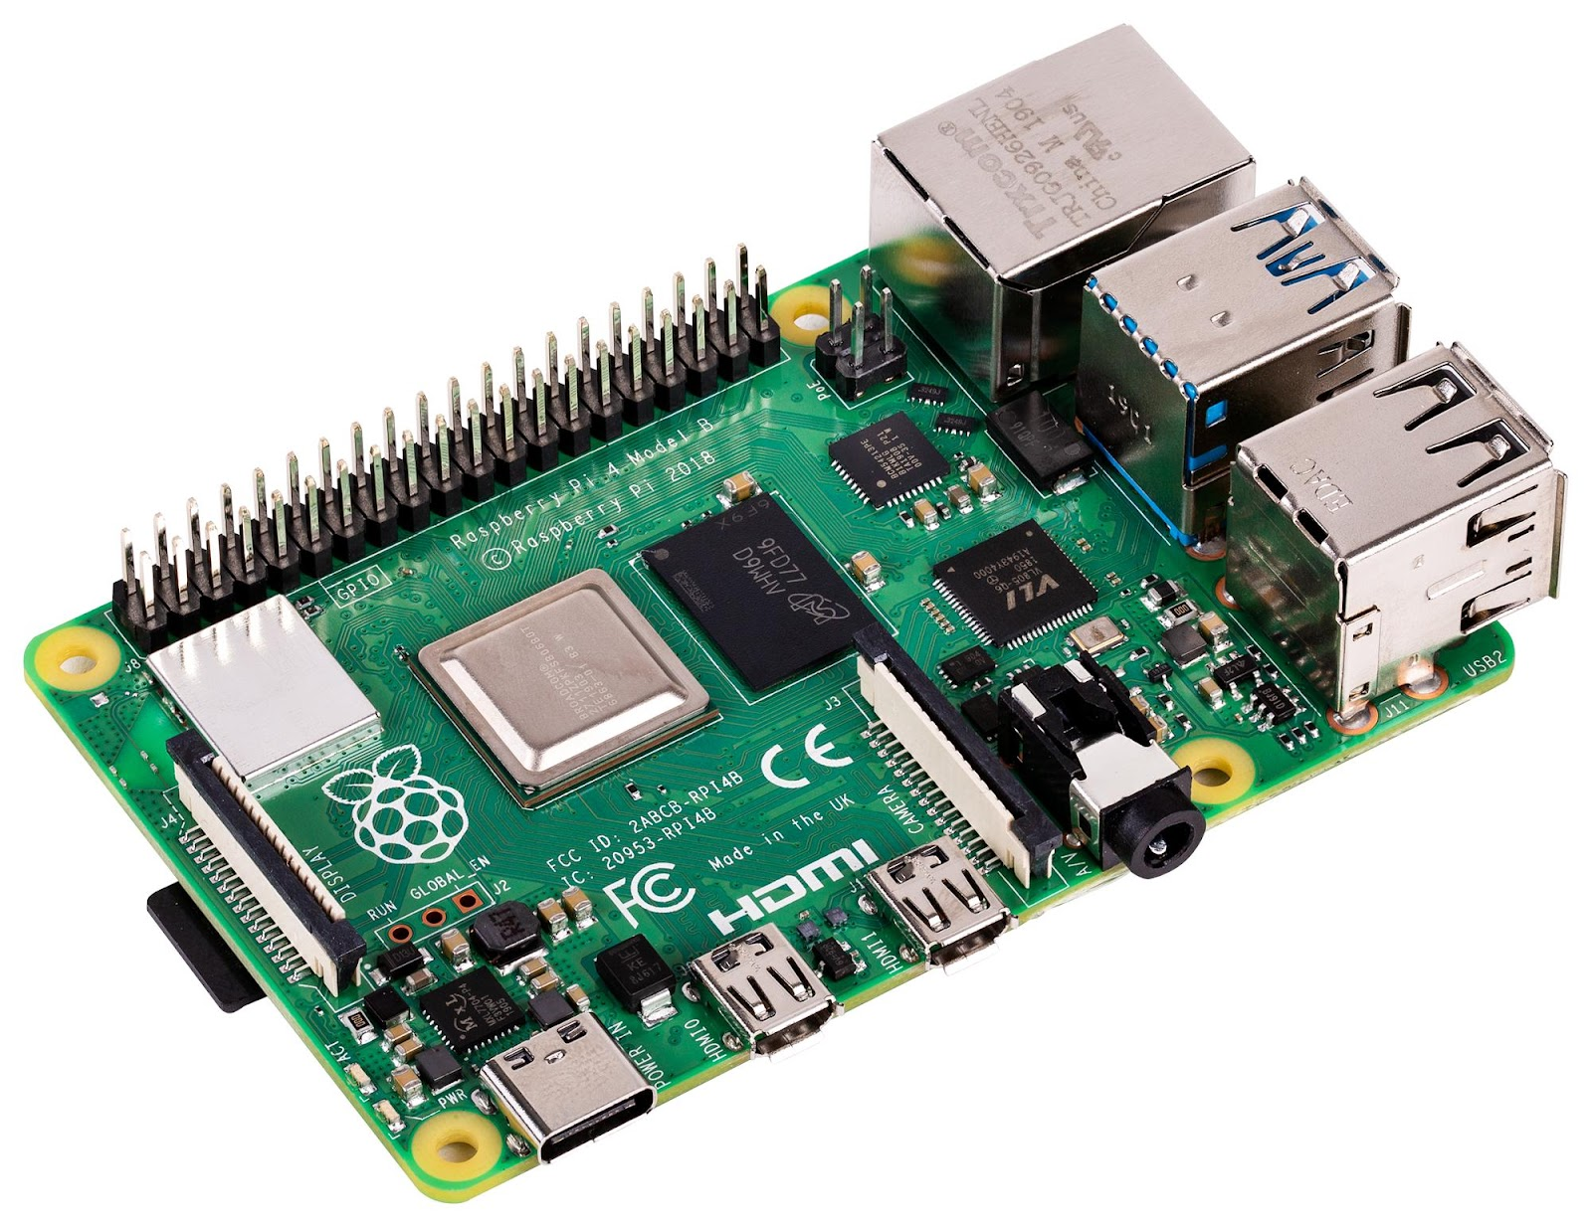
Arduino Uno
Raspberry Pi

Slide 24
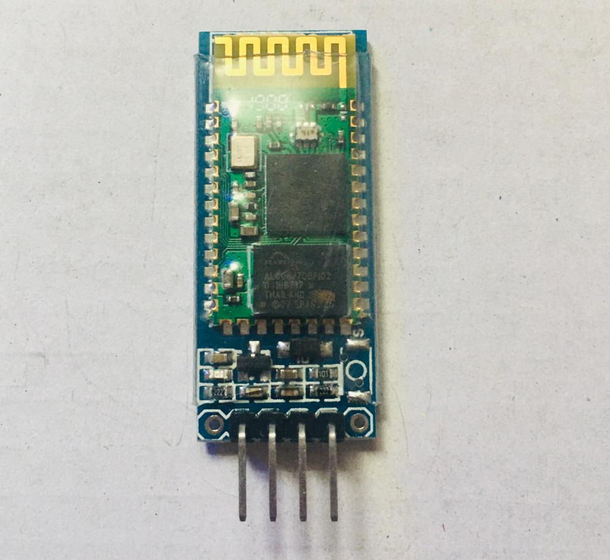
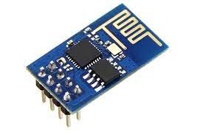
Bluetooth HC-06
Wi-Fi module

Slide 25


Android application using flutter
Android application using java

Slide 26
Hardware Components

Slide 27
Microcontroller Arduino(UNO/ATmega328)

Slide 28
Ultrasonic Sensor
HC-06 Bluetooth module

Slide 29
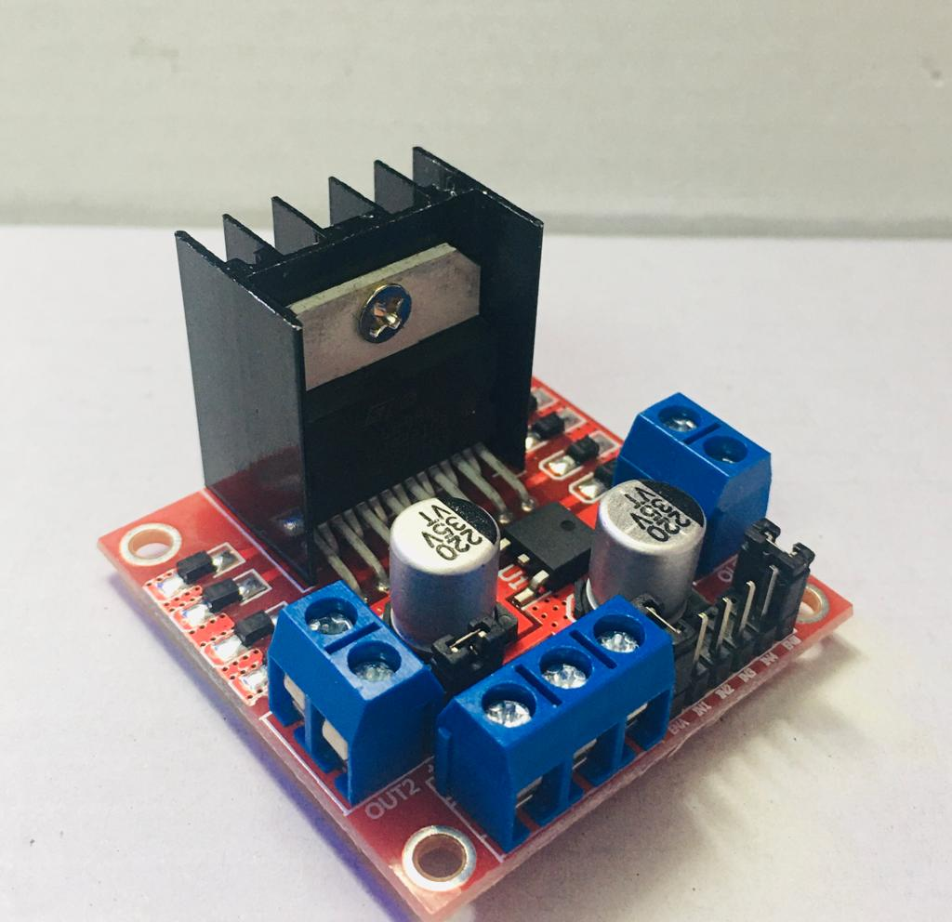
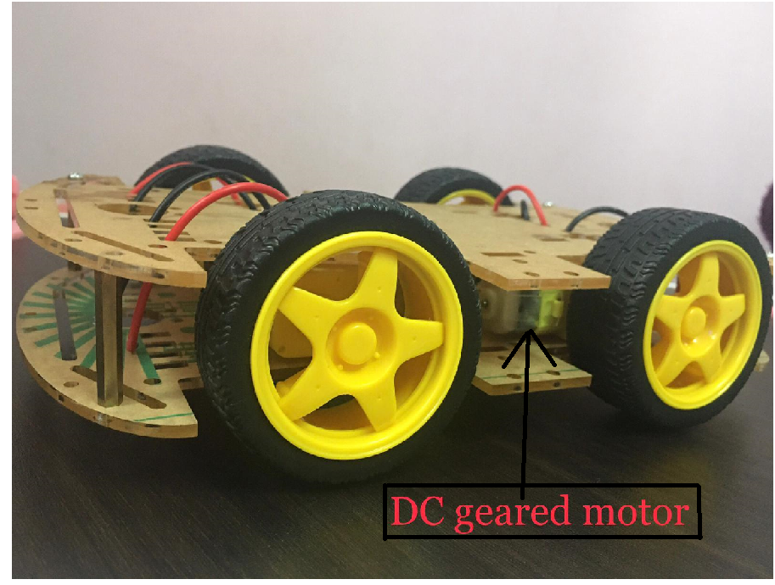
Car with 4 DC Geared Motors
Motor Drive Module Board (L298N Dual H-Bridge)

Slide 30
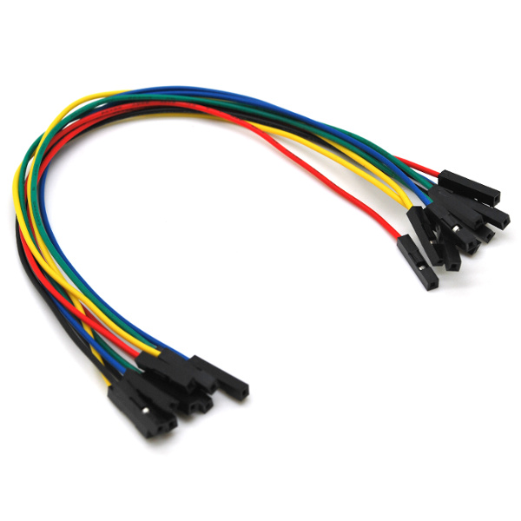
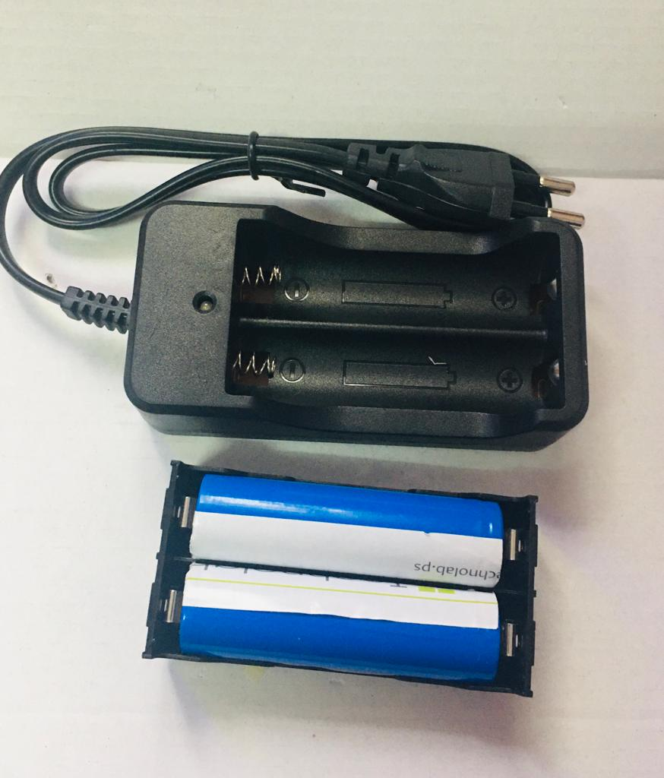
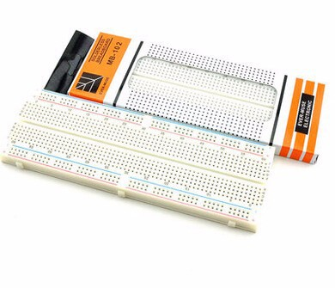
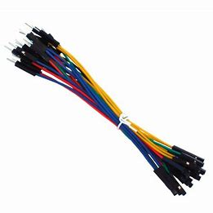
Power supply
Breadboard
Wires

Slide 31
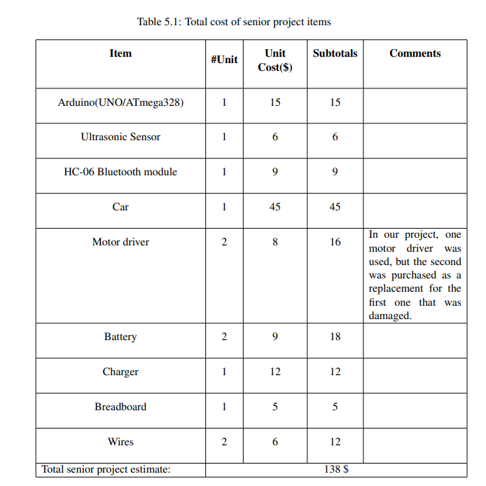
Cost

Slide 32


Simulation

Slide 33
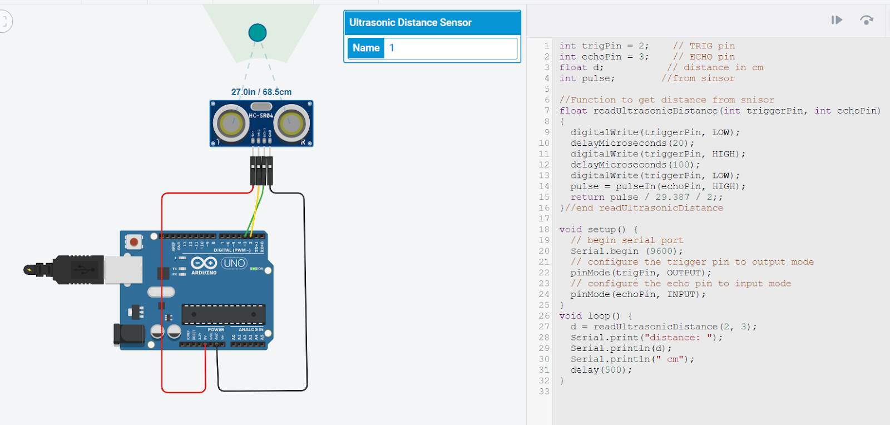
Find the distance using an ultrasonic sensor

Slide 34
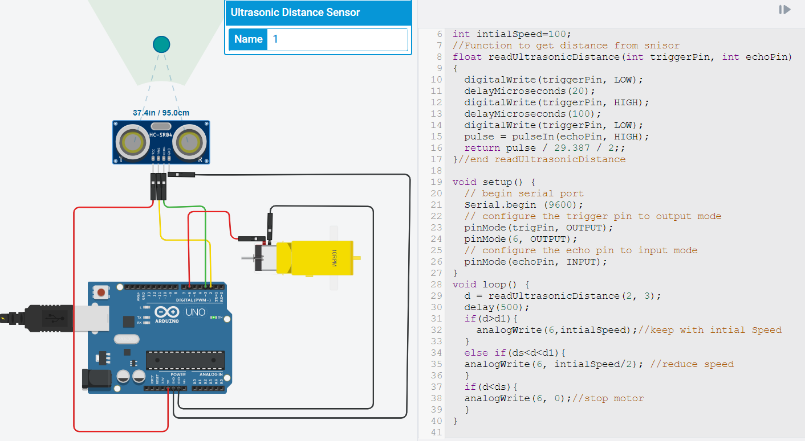
Control motor speed according to distance

Slide 35
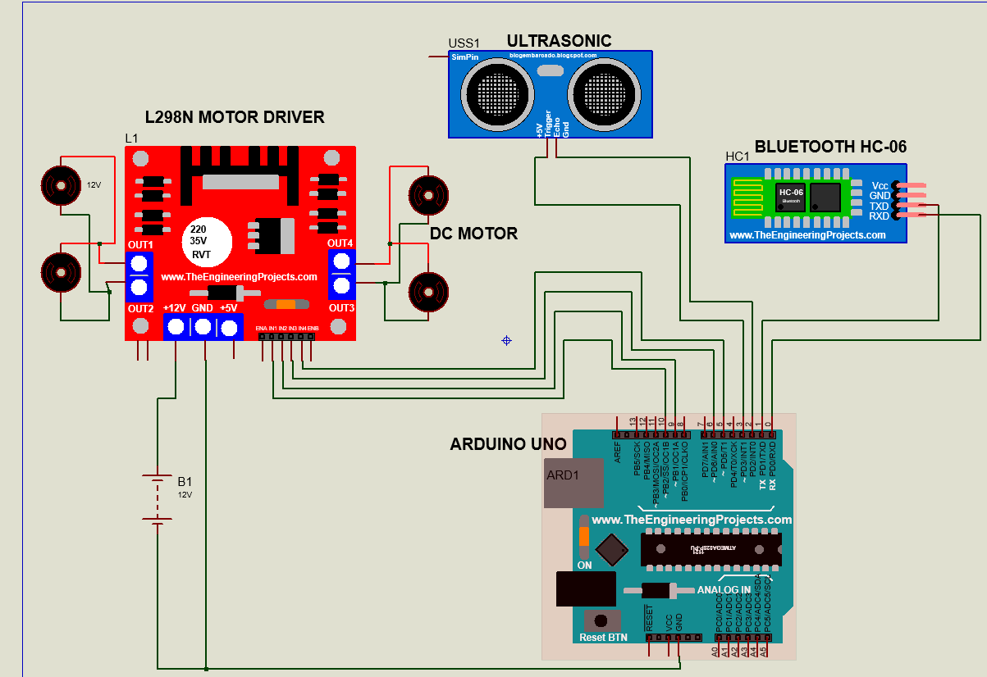
System Connections

Slide 36
Constraints
The components were not readily available in our city, and obtaining them required some effort.
External circumstances caused the hardware parts to fail, requiring us to purchase the parts (Arduino, drivers) again, increasing the project cost.
The Bluetooth connection modules maximum range is 9 meters, so the capacity to manage the automobile is limited.
Because it is costly to cover all of the pieces required to achieve all of the functions in ADAS, we have picked one of these features.

Slide 37
RESULTS AND DISCUSSIONS
CH 4

Slide 38
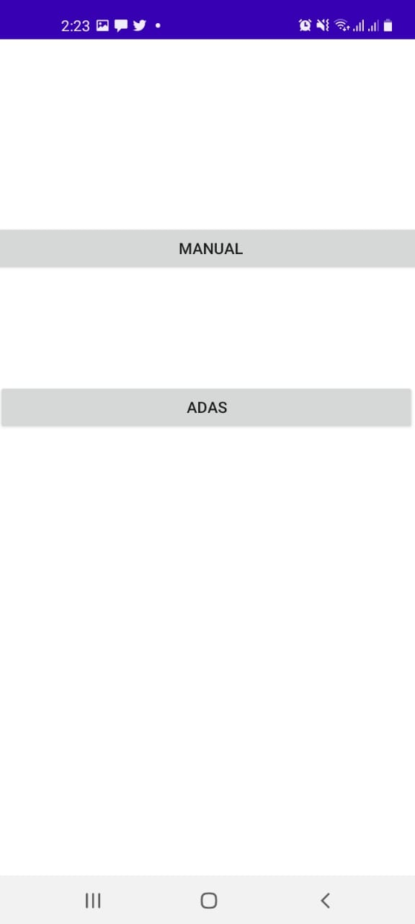
Main page

Slide 39
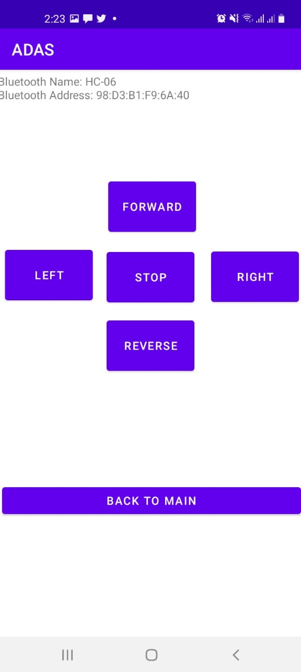
Manual driving page

Slide 40
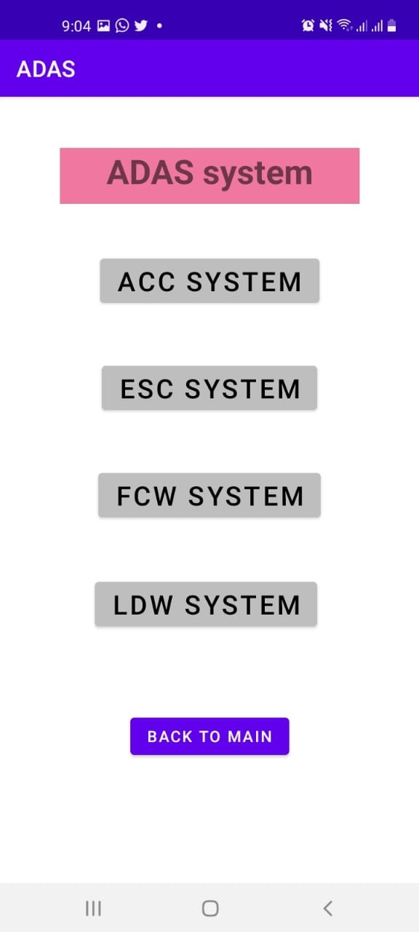
ADAS page

Slide 41
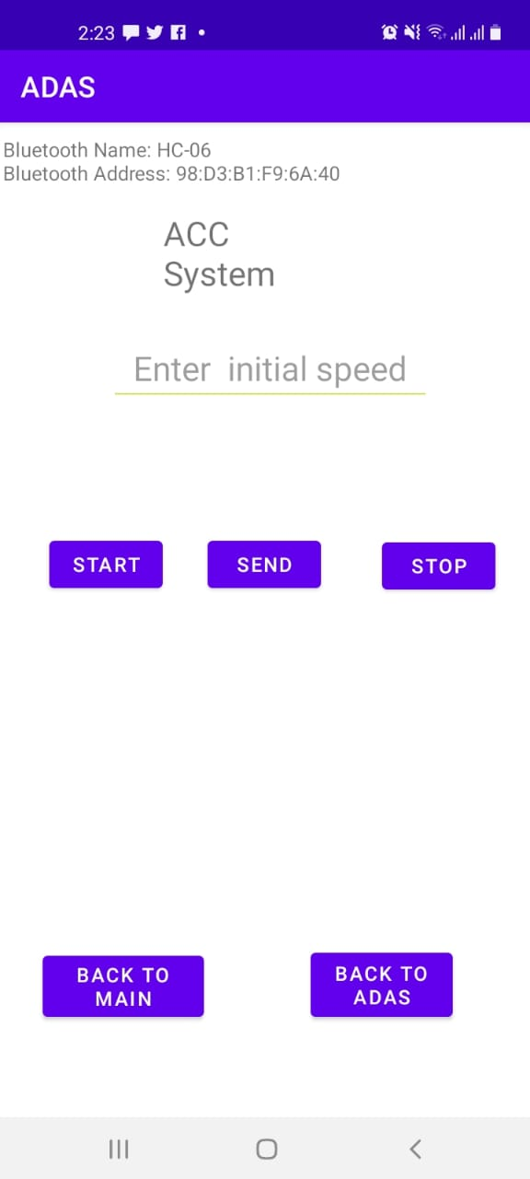
ACC page

Slide 42
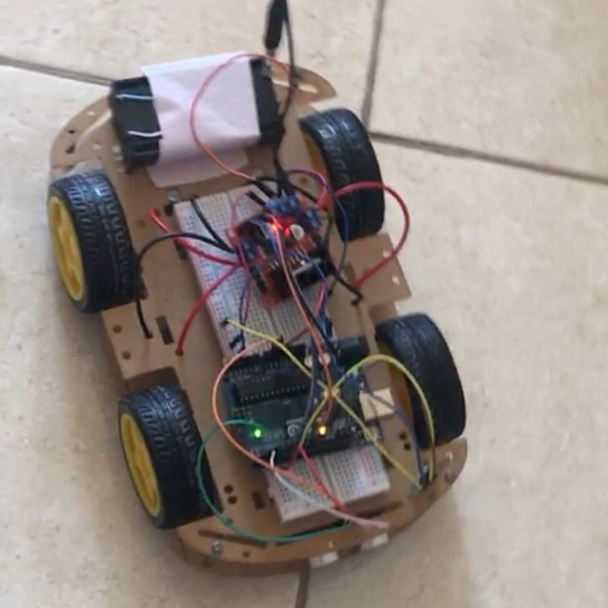
Final form of the car

Slide 43
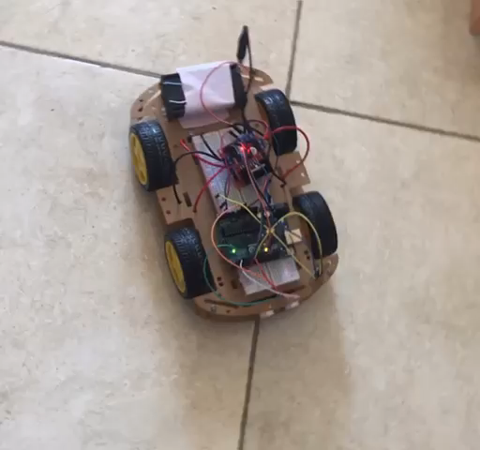

Slide 44
PROJECT MANAGEMENT
CH 5

Slide 45
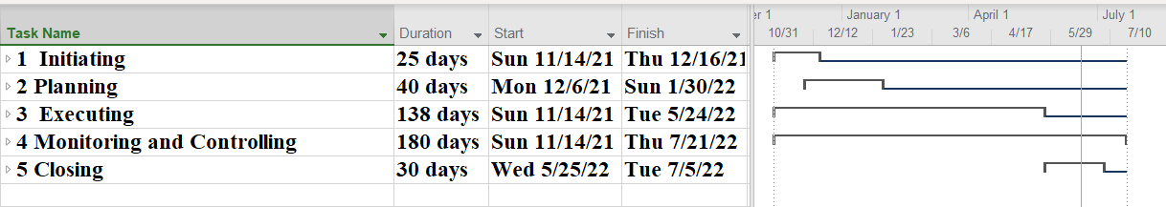
Tasks, Schedule and Milestones

Slide 46




Lessons Learned
1

Slide 47
IMPACT OF THE ENGINEERING SOLUTION
CH 6

Slide 48
Economical, Societal and Global
The ACC system will reduce the number of accidental deaths and injuries.
Saves you money by increasing your gas mileage and thus minimizing your vehicle’s fuel consumption.
keep inside the speed limit, there are fewer speeding tickets.

Slide 49
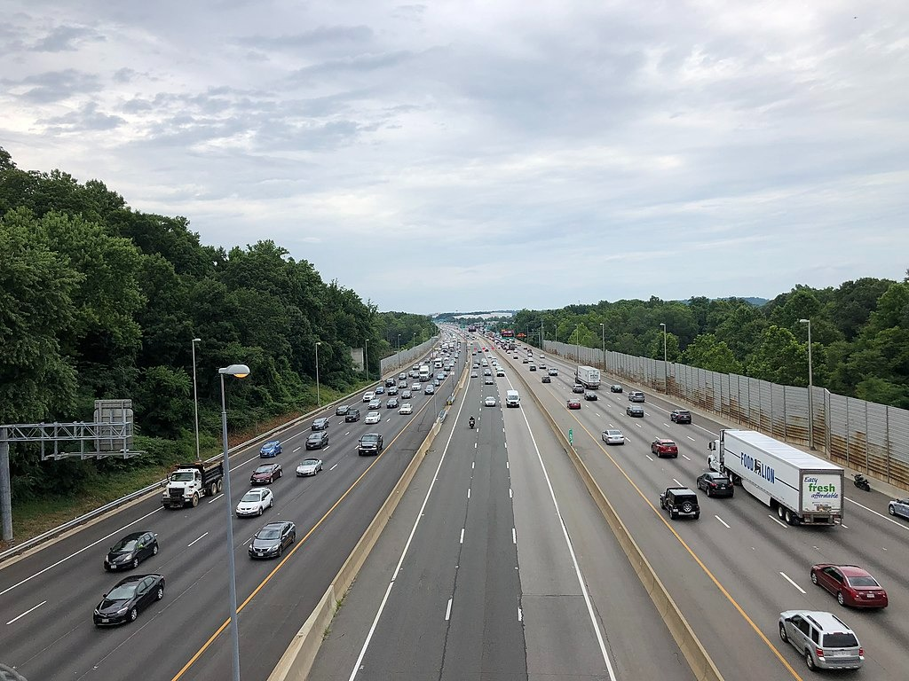
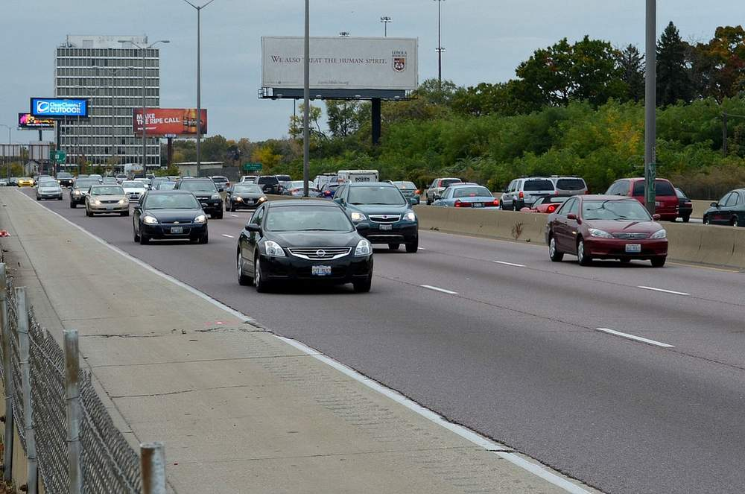
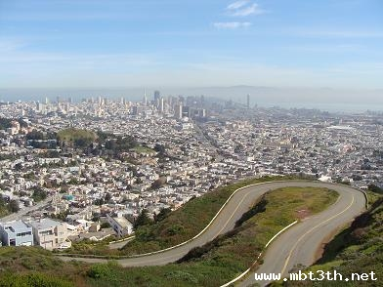
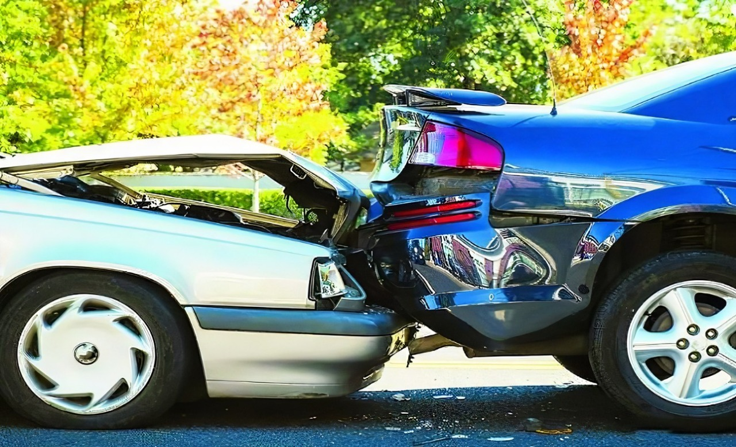
Environmental and Ethical

Slide 50
Recommendations for Future Work
The ability to connect via 3G and 4G networks could be added to the system in the future.
The ACC’s behaviour improved on non-straight roads, particularly roundabouts, up and down hills, and in windy conditions.
Integrating ACC with other ADAS assistance systems, such as automatic parking, which assists in moving the vehicle from a traffic lane to a parking space, and a car navigation system, which assists in finding direction in an automobile.

Slide 51
Prepared by:
Ameerah Kmail
Sally Zaqzouq
Hiba Alawna
Supervised by: Prof. Hazem Khanfar

Slide 52
Thanks!
Any questions ?
😉❤

